Slide 1

Bond Graph Modelling
23AID201
Lecture 3
Dr. Mrittunjoy Guha Majumdar
School of Artificial Intelligence, Amrita Vishwavidyapeetham Delhi NCR

Slide 2
What is Bond Graph Modelling?
Bond graphs provide a unified way to describe dynamic behavior of systems across multiple domains (electrical, mechanical, hydraulic, thermal, etc.) based on energy exchange.
The method relies on physical analogies beyond equations, emphasizing common energy concepts across domains.
Bond-graph sub-models are reusable, non-causal components that can be treated as objects in object-oriented physical system modeling.
Bond graphs are labeled, directed graphs where vertices represent sub-models (idealized physical phenomena) and edges (bonds) represent energy connections between ports.
Vertices may represent either equations or entire bond graphs, enabling hierarchical and modular model construction.
Each bond carries power and has two directions: power direction (for sign convention) and computational causality direction (input vs. output variables). Equations may need rewriting depending on assigned causality.
Bond-graph models can integrate with block diagrams, having power ports, signal inputs, and signal outputs as interfaces.
The concept originated with Paynter (1961), expanded by Karnopp & Rosenberg (1968–1990), refined by Thoma (1975) and Van Dixhoorn (1982), and formalized into a thermodynamic systems theory framework by Breedveld (1984–85).

Slide 3
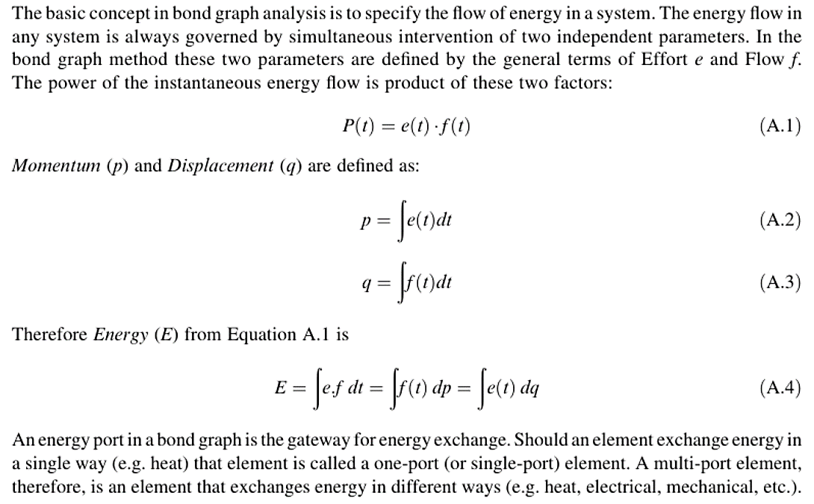

Slide 4
Elements of Bond Graphs
Source (or Active Elements), Passive Elements, Converters and Junctions

Slide 5
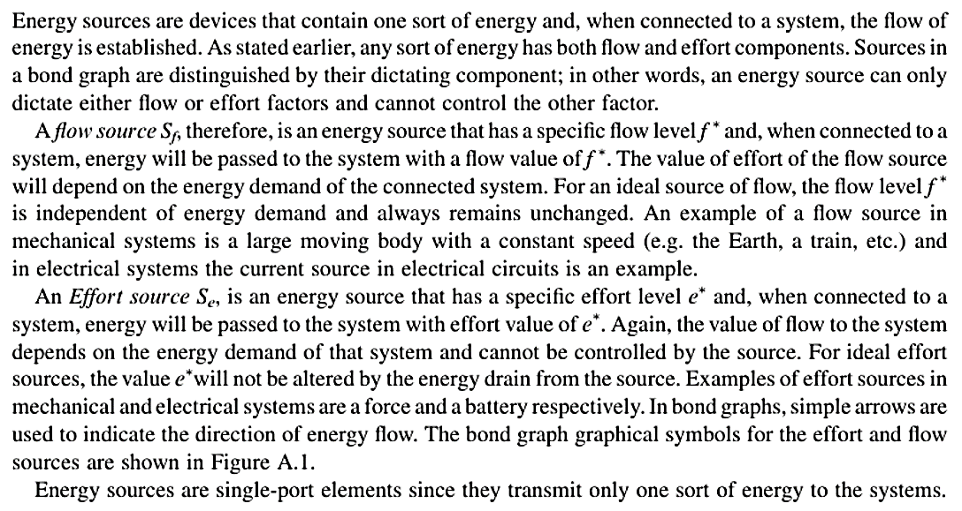
Sources

Slide 6
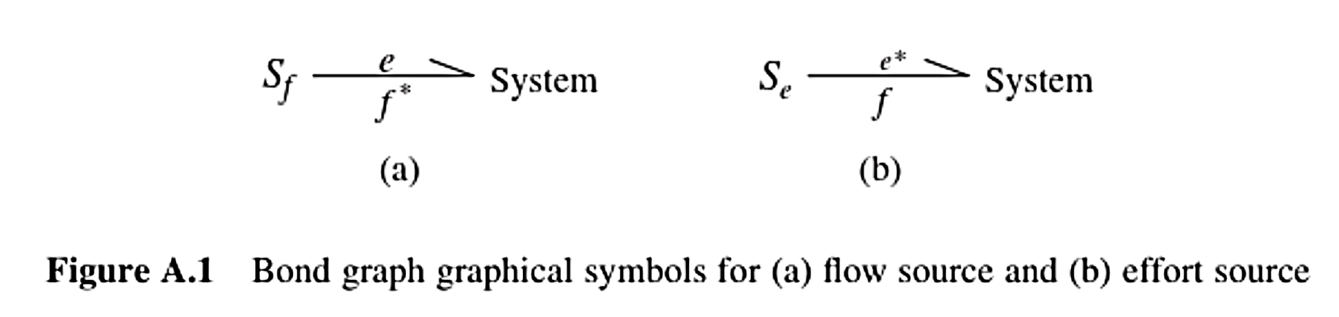

Slide 7
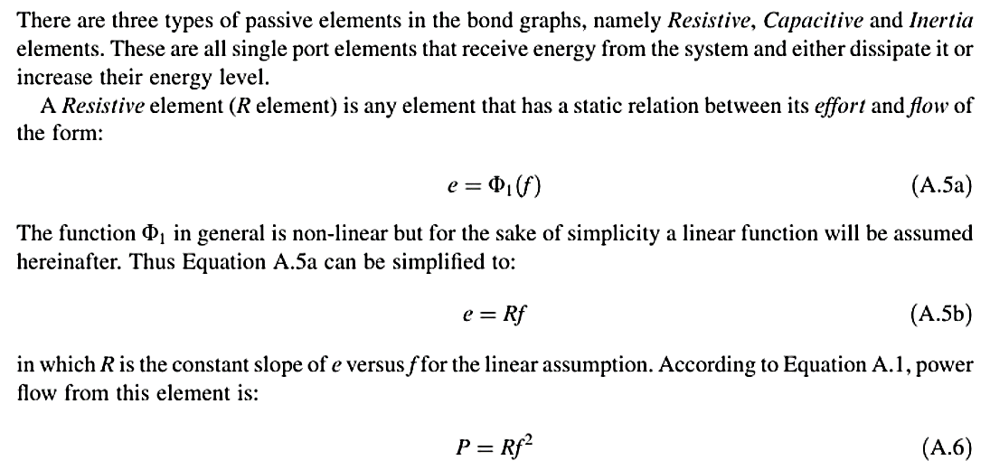
Passive Elements

Slide 8
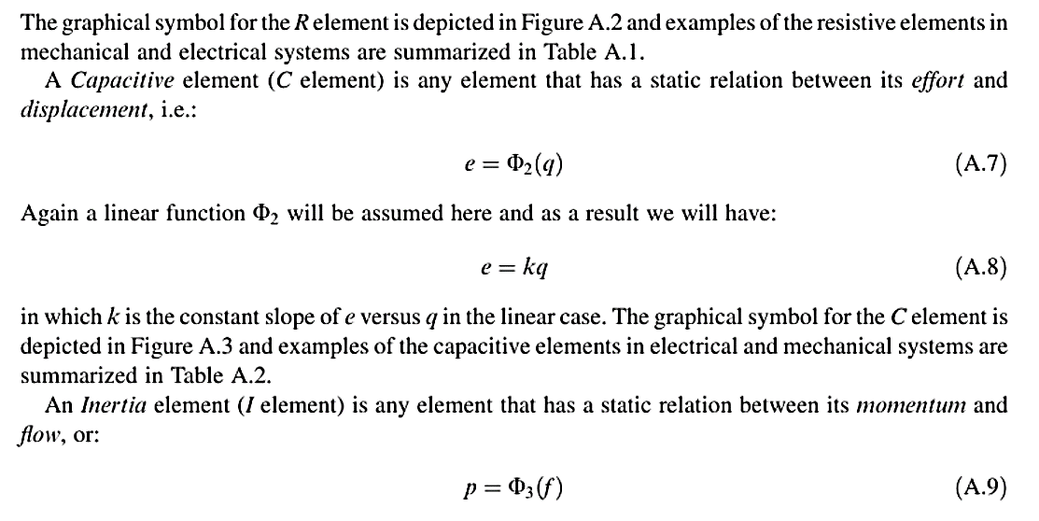
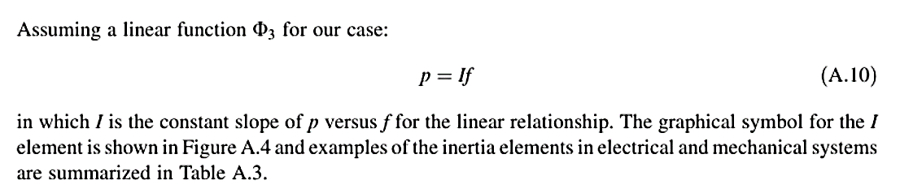

Slide 9
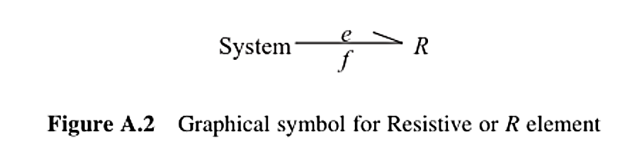
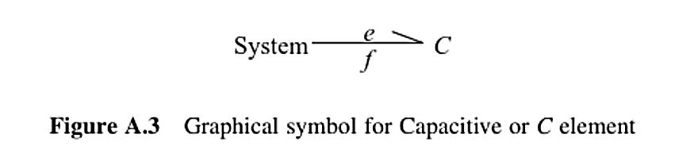
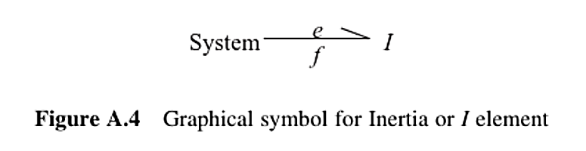

Slide 10
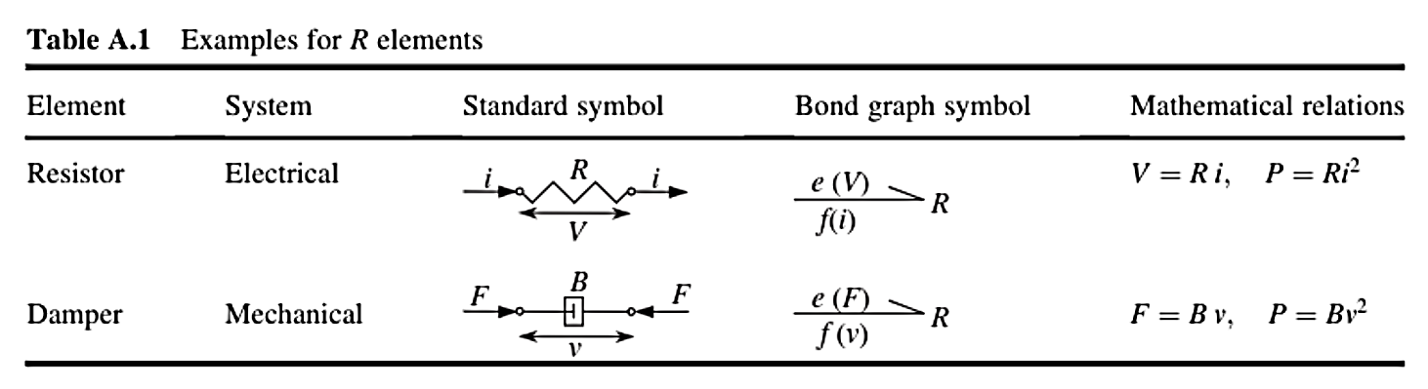

Slide 11
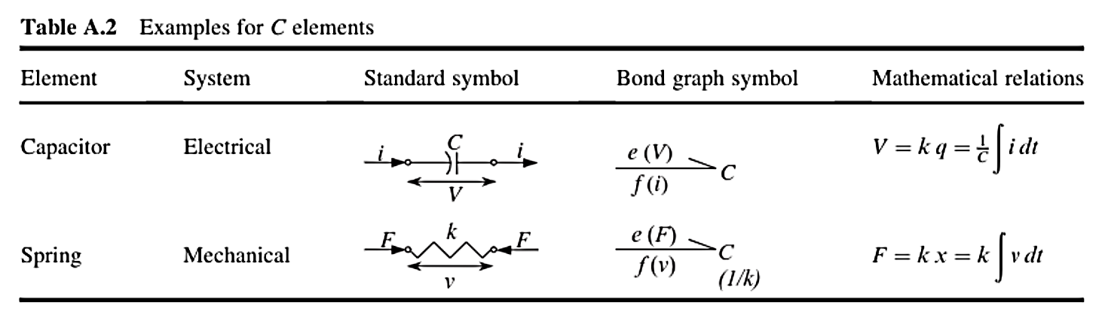

Slide 12
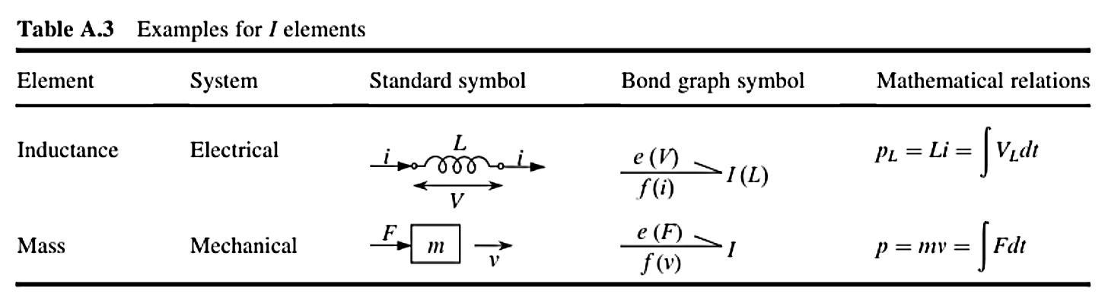

Slide 13
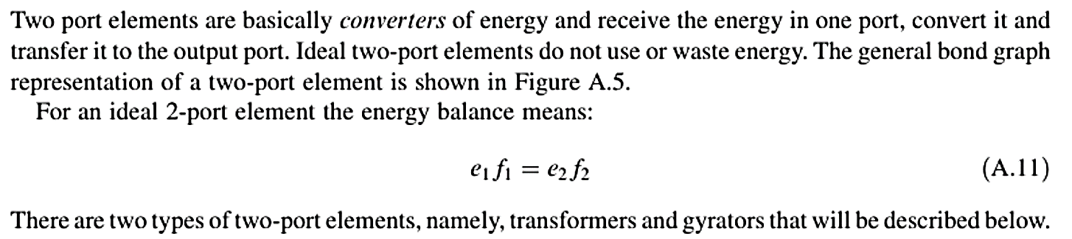
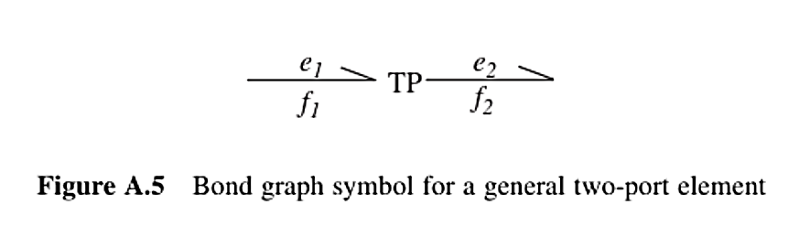
Two-Port Elements

Slide 14
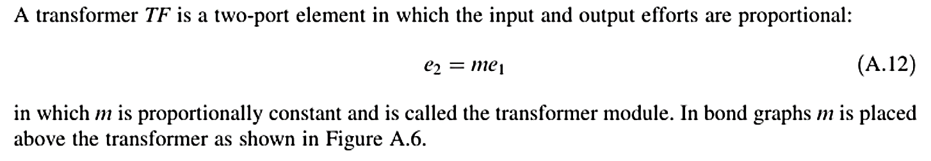
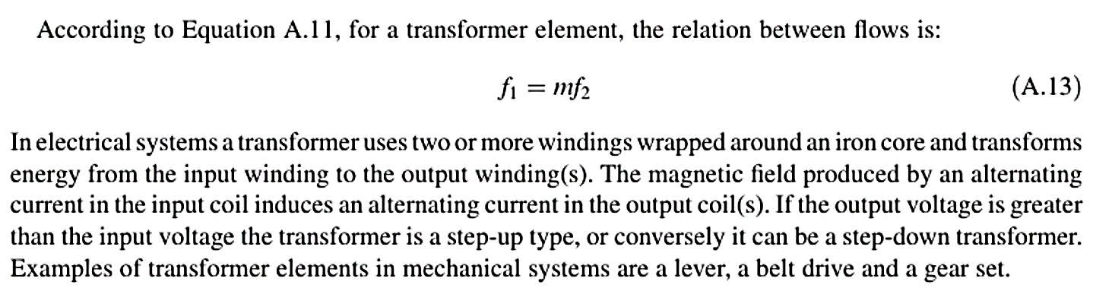
Transformer

Slide 15
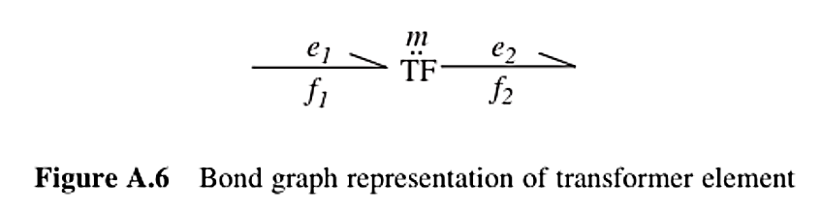

Slide 16
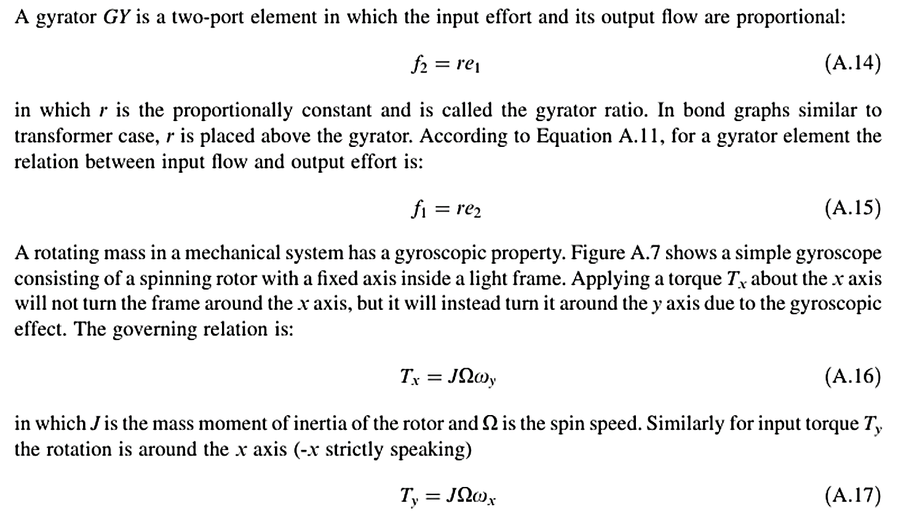
Gyrator

Slide 17
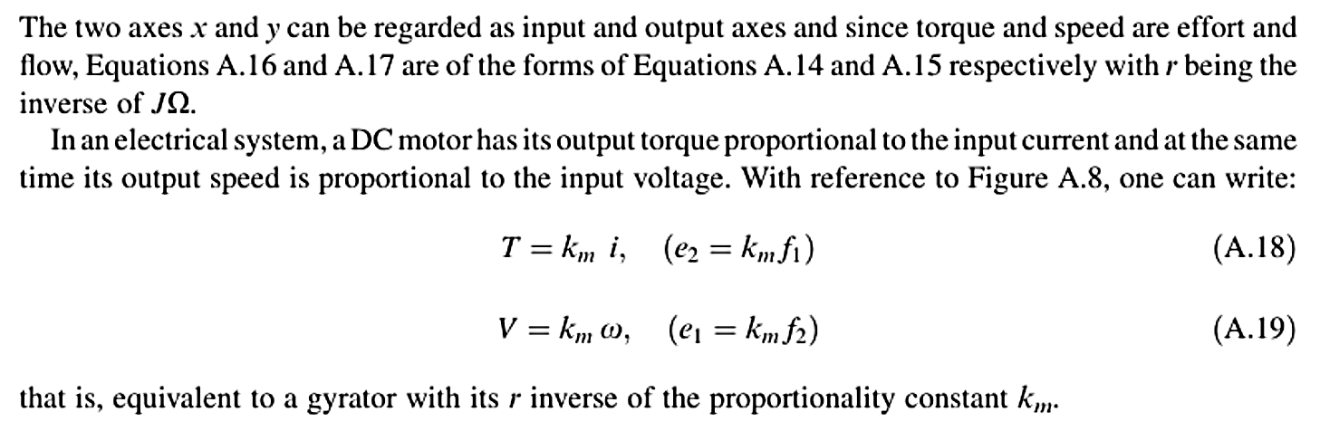
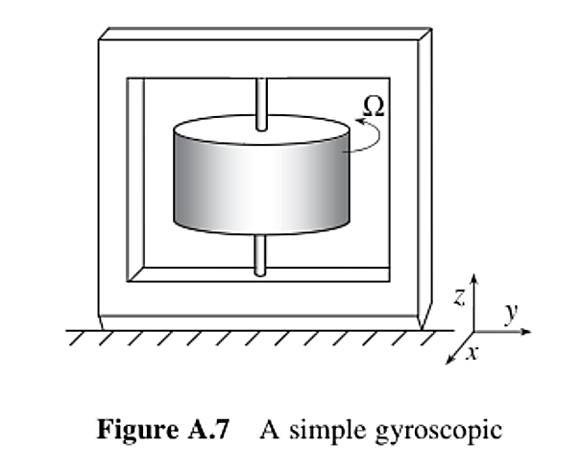
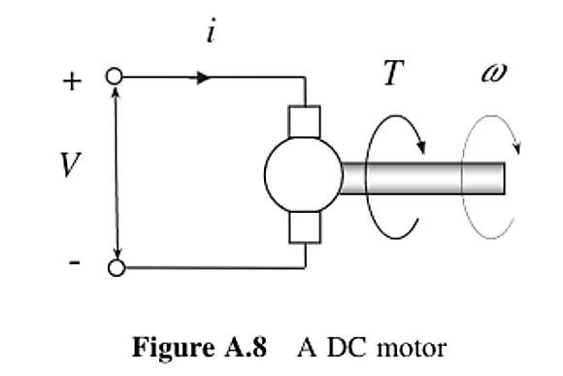

Slide 18
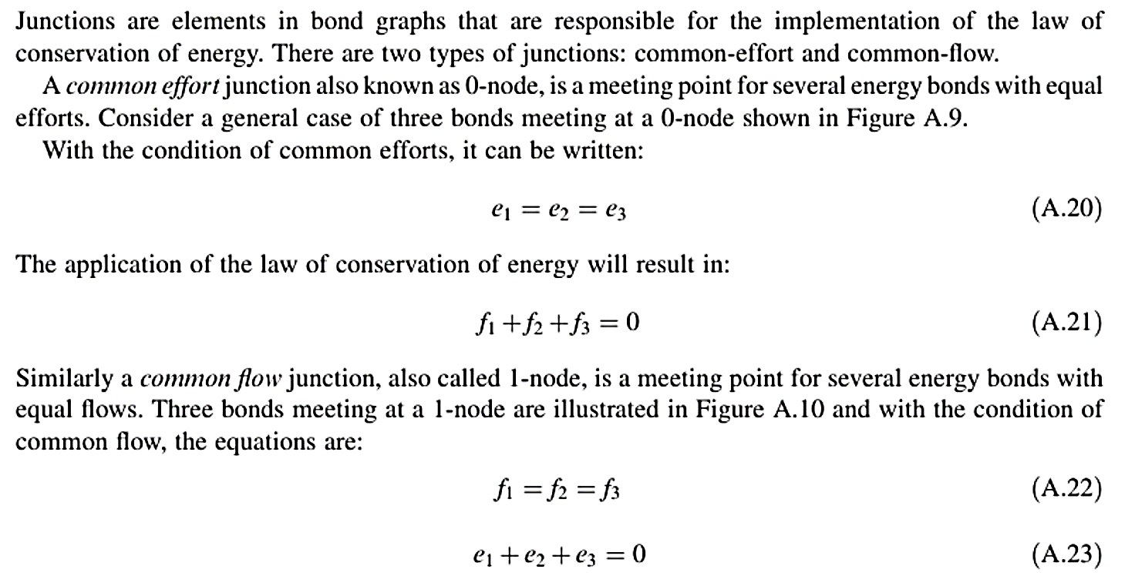
Junctions

Slide 19
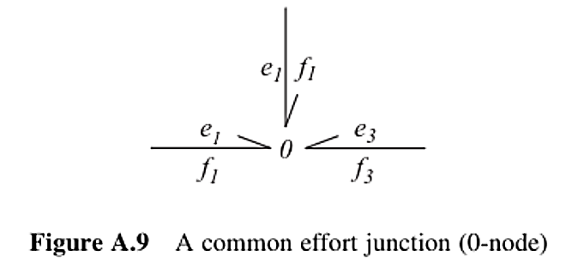
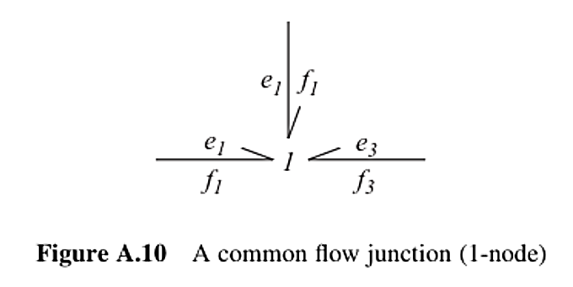

Slide 20
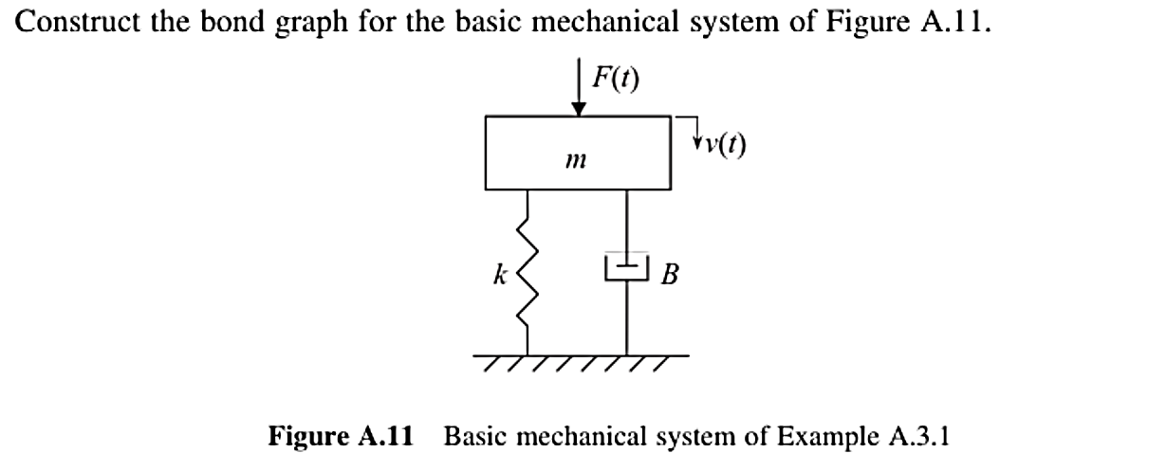
Example

Slide 21
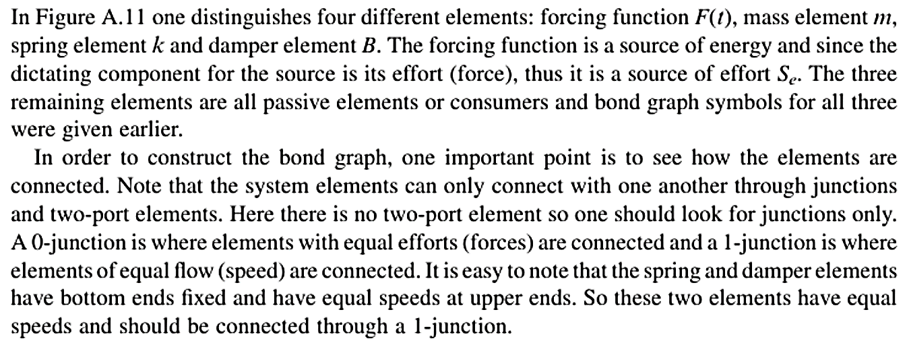
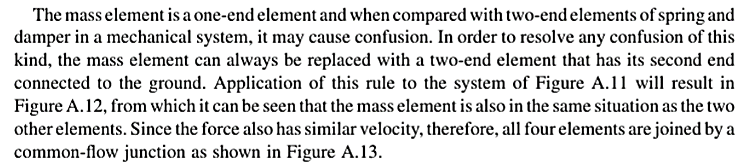
Solution

Slide 22
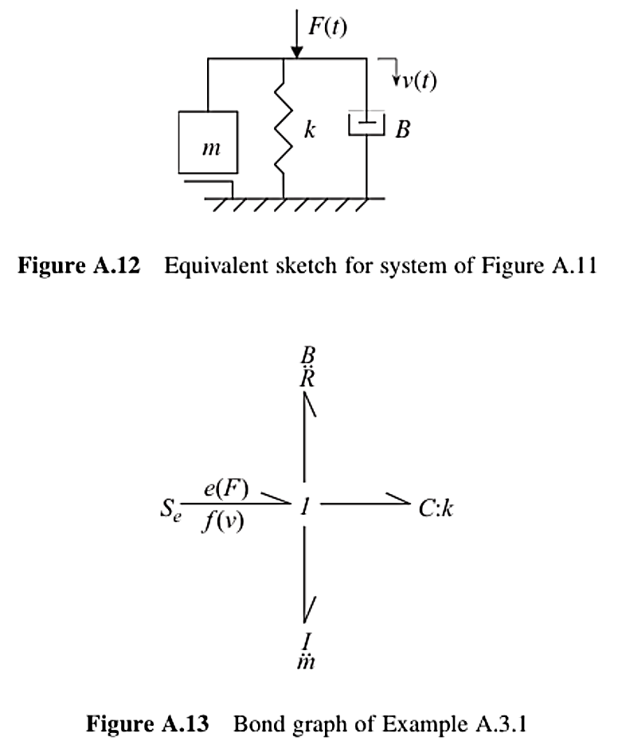

Slide 23
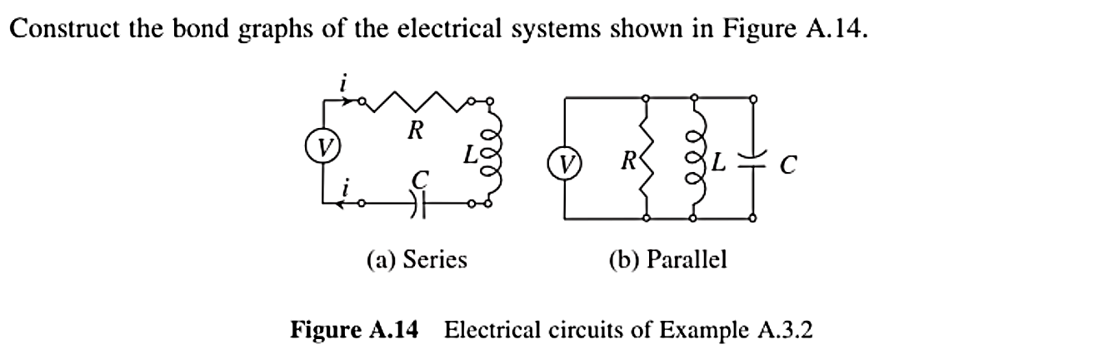
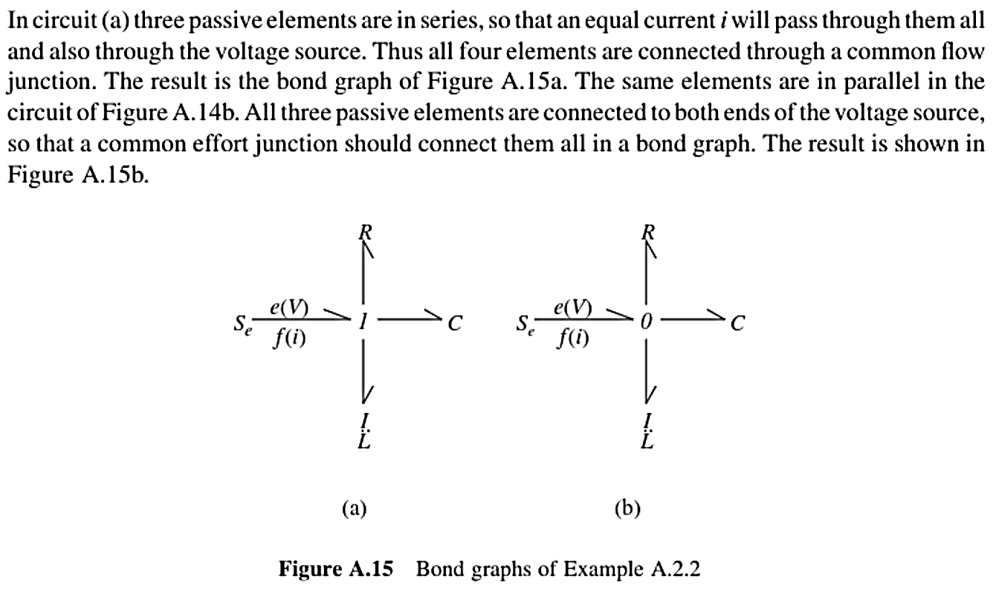
Example
Solution

Slide 24
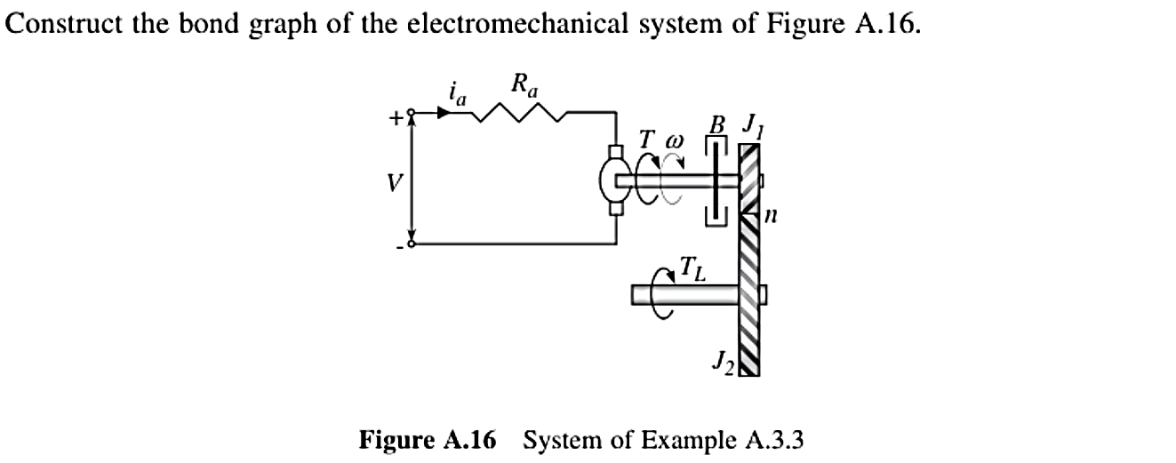
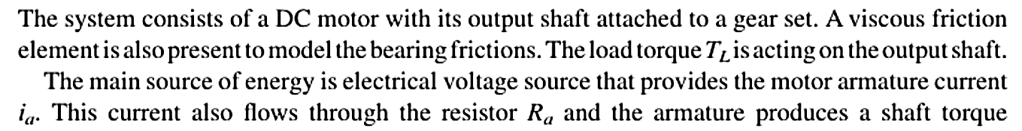
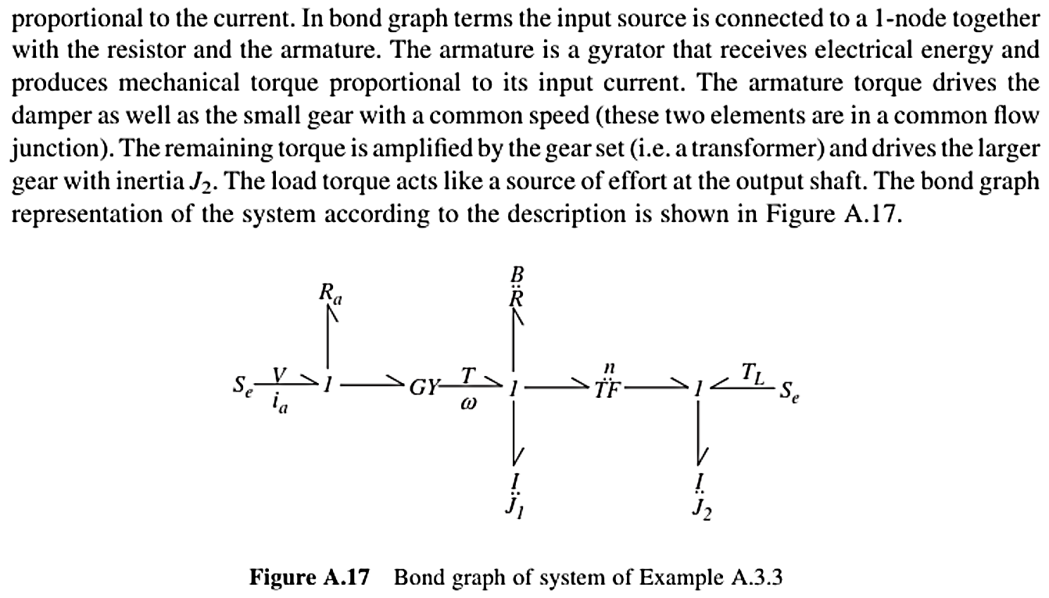
Example
Solution

